Slide 1
Manual Testing
Application - ZOHO CRM
Presented by - Mahe

Slide 2
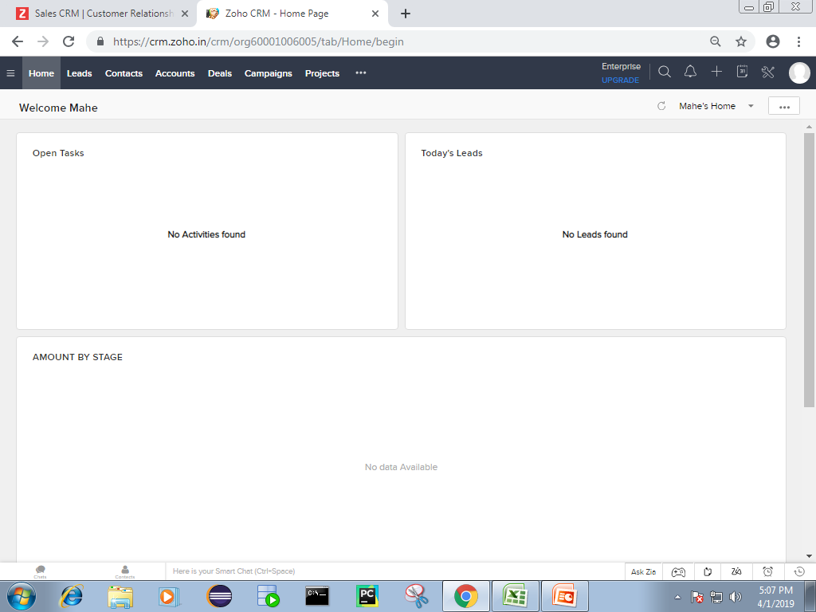
Homepage

Slide 3
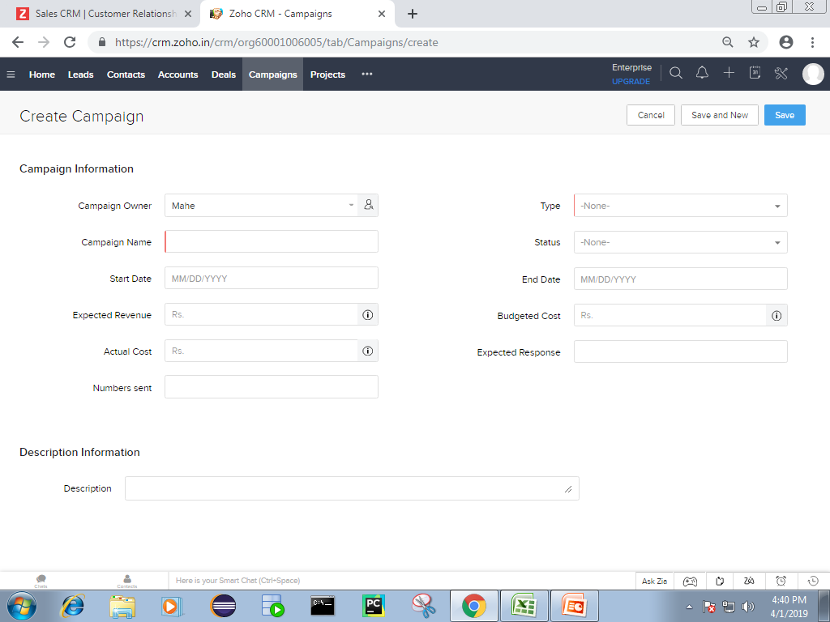
Create Campaign

Slide 4
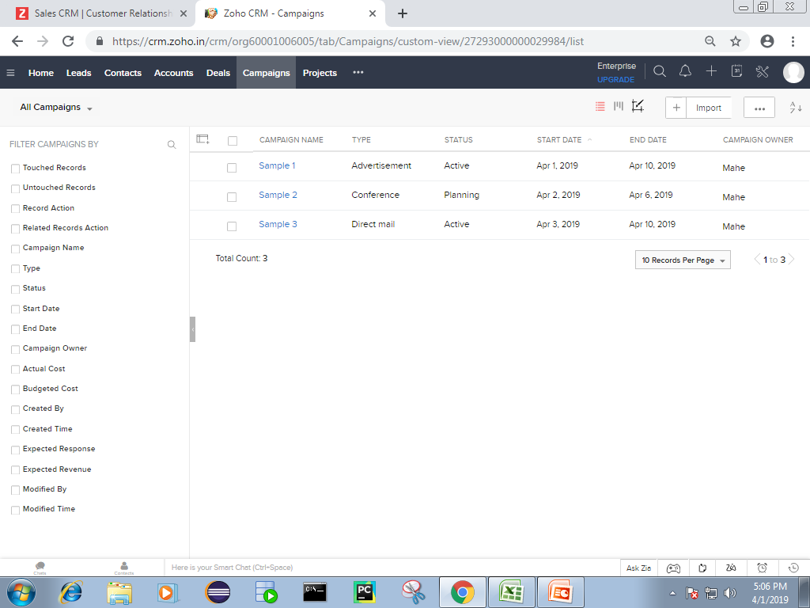
Campaign List

Slide 5
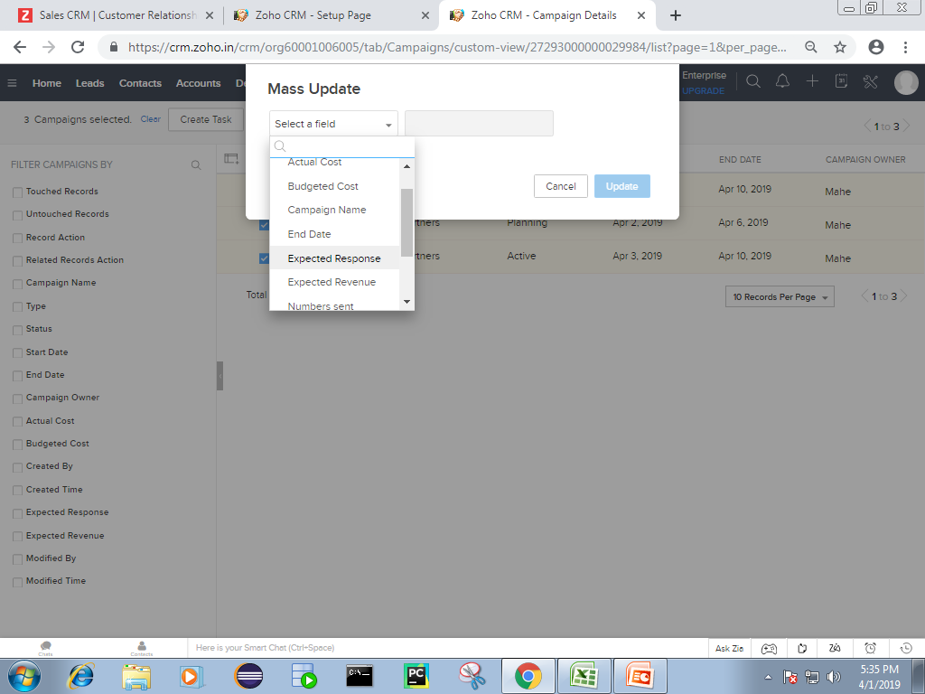
Mass Update

Slide 6
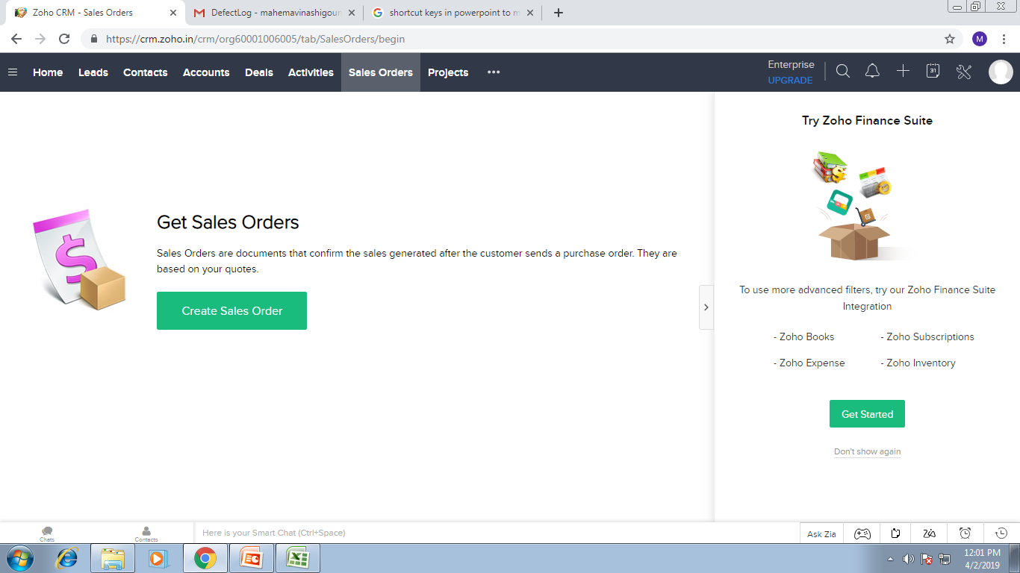

Slide 7
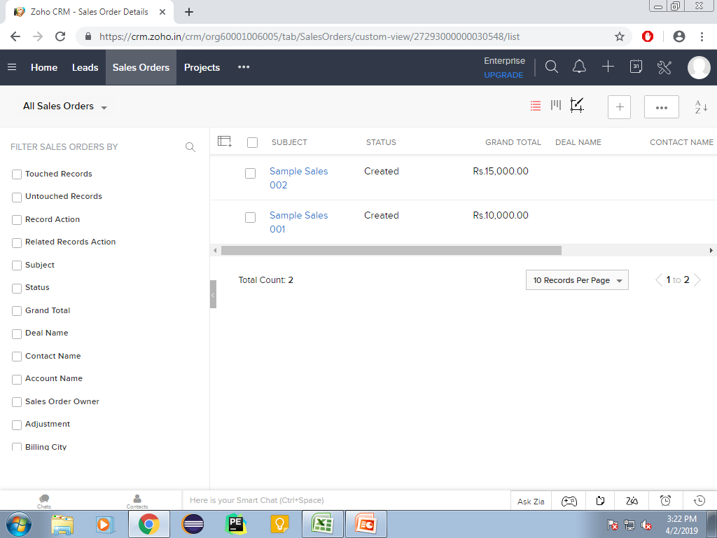

Slide 8
